Slide 2
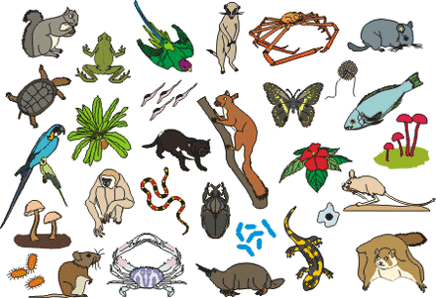
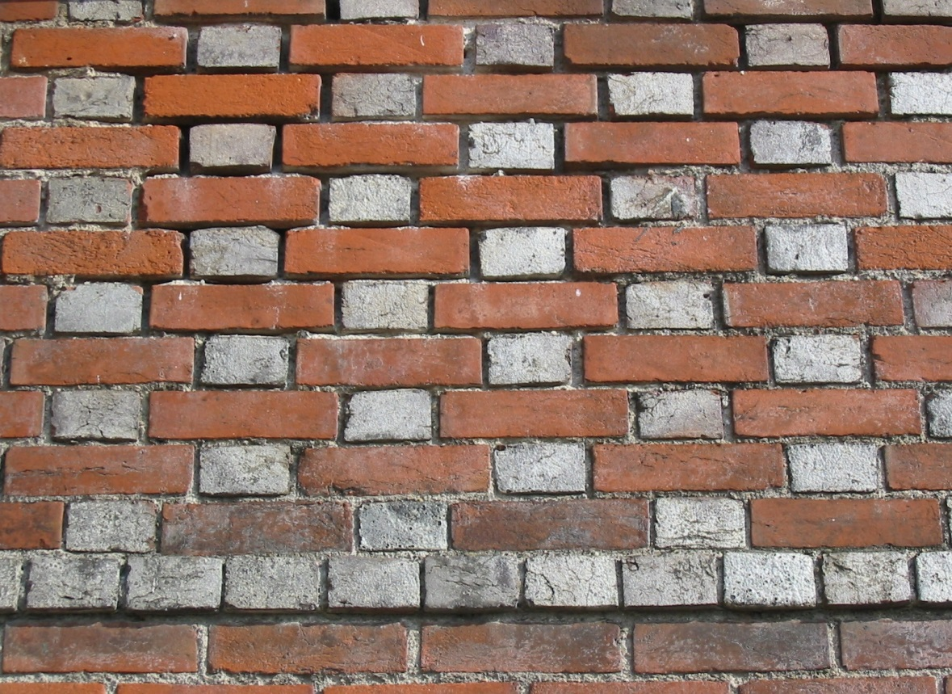
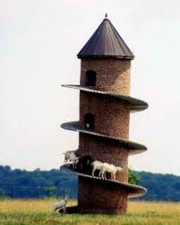
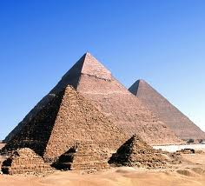
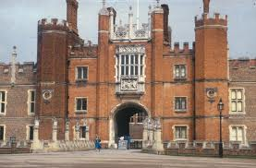
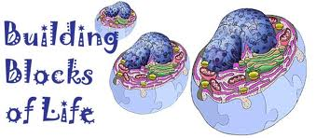
Living organisms
They also differ in size and shape.
Similarly there are millions of living beings on this earth.
Observe the following structures
They all are made up of Bricks.
Bricks are the basic building blocks.
But they all are made up of same building blocks.
They look very different from each other.
These building blocks are called as CELLS.
They differ in shape and size.
TOWER
MONUMENTS
BUILDINGS
But do they have any common properties?
YES!!!!

Slide 3

So how do we define a cell ?
Cell is the common basic, structural and functional unit of living beings.

Slide 4
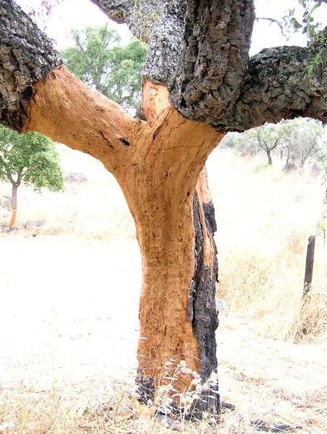
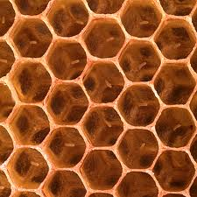

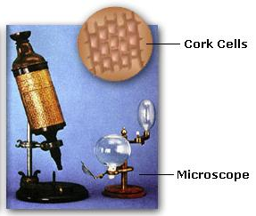
DISCOVERY OF CELLS
Observed a thin slice of cork
(bark of a tree)
In the year 1665
There were
EMPTY COMPARTMENTS
Which resembled
Structure of honey comb
Under a self designed microscope
Robert Hooke
He labelled them as
Cells
In Latin cells means ‘small rooms’

Slide 5
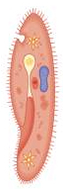
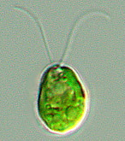
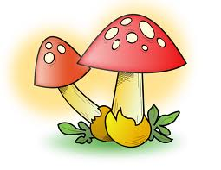

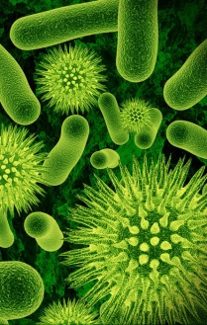
Living Organisms
are of two types
Unicellular
Multicellular
In unicellular organisms, all functions are carried out by the single cell
Many cells group together in a single body and assume different functions in it to form various body parts.
Made of single cell
Made of many cells
E.g. Chlamydomonas,
Paramoecium,
bacteria etc.
E.g. Some fungi, plants and animals.

Slide 6
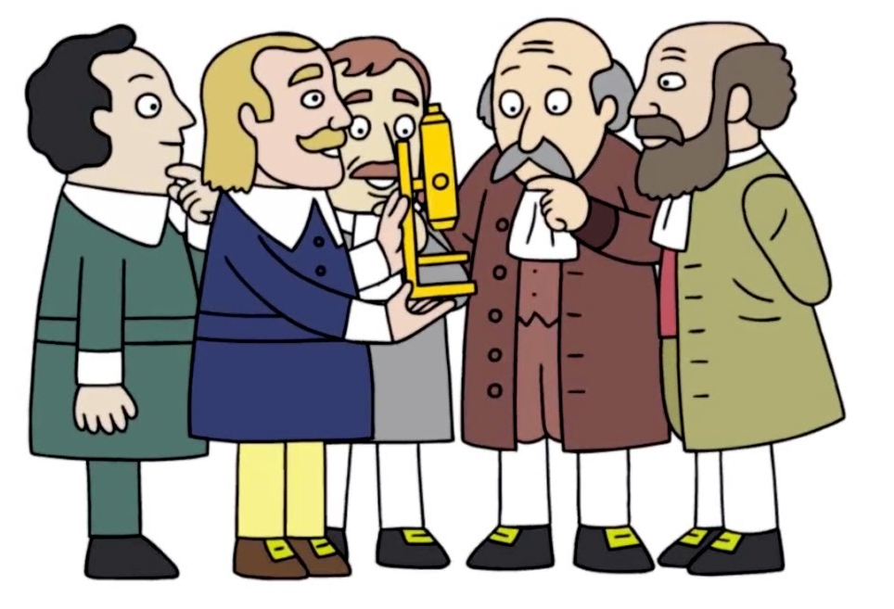
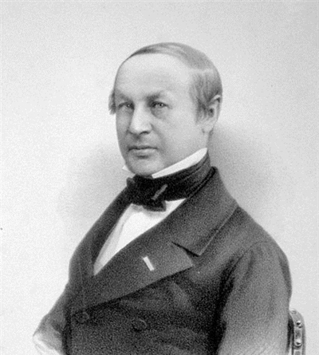
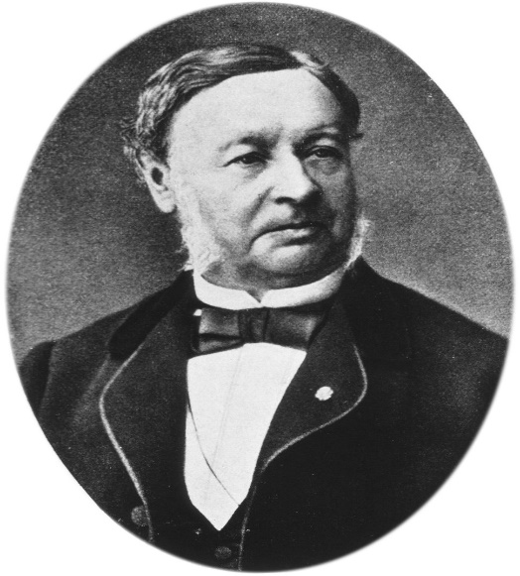
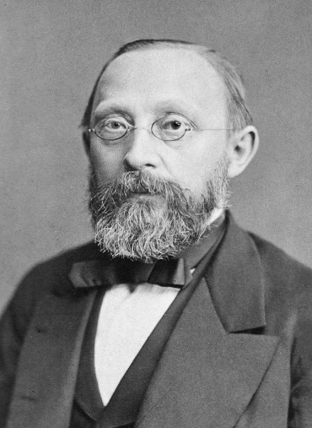
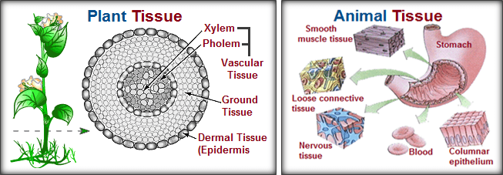
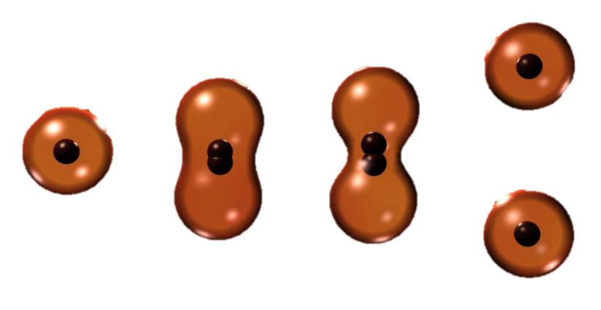
CELL THEORY
The first theory was proposed by M.J. Schleiden and Theodore Schwann (1838-39).
It states that “All plants & animals are composed of cells and cell is the basic unit of life.”
In 1885, R. Virchow modified this theory by suggesting that
Different scientists proposed different theories regarding the study of cells.
“All cells arise from pre-existing cells”

Slide 7
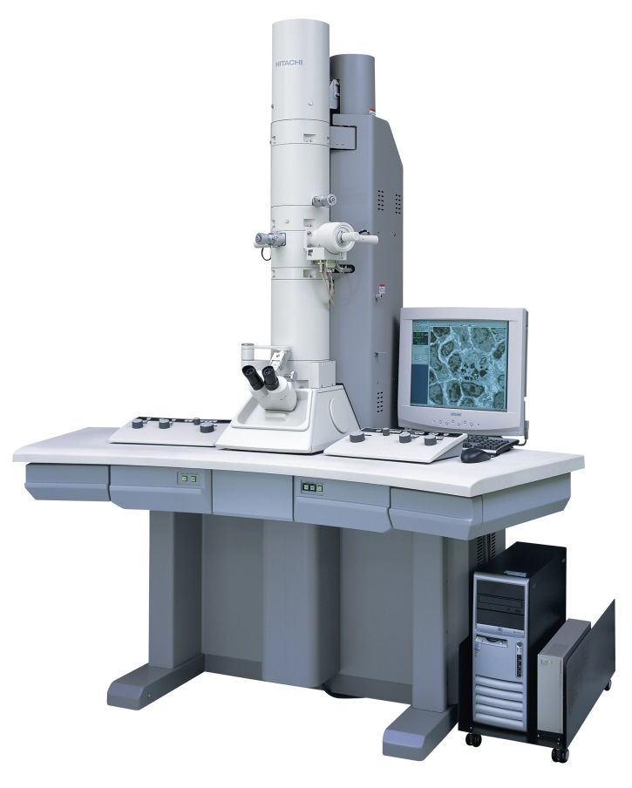
With the discovery of electron microscope in 1940, it was easy to understand the complex structure of a cell.

